Slide 1
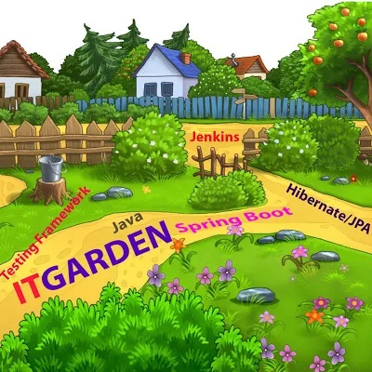
SPRING BOOT WEB SERVICE
Spring Boot Web Service is very easy to implement. We should learn about some annotation that’s it. You can focus only your Business implementation

Slide 2
Spring Boot Rest Fundamentals
Common Web Service Terminology
HTTP Header
HTTP Request
HTTP Response
HTTP Method
HTTP Status Code
Spring Boot Annotation for Web Service
@RestController
@RequestMapping
@GetMapping
@PostMapping
@PutMapping
@DeleteMapping
@RequestBody
@PathVariable
@RequestParam

Slide 3
Web Service Architecture
Client App 1 Browser
Hosting Server
Client side API to access Web Service
Request / Response
Web App deployed in Tomcat or Apache or any other available server
Data Transfer in JSON OR XML
Client App 2 Mobile
Web Server
Request / Response
Data Transfer in JSON OR XML
Client App 3 Any device like Smart TV etc
Request / Response
Rest Access the method through endpoint
http://www.facebook.com/login http://www.facebook.com/add

Slide 4
Web Service Best Practice
Creating endpoint as readable. The Web Service consumer should understand the use of ENDPOIT while reading the endpoint.
Proper Exception handling.
Use plurals in your endpoint while access your resource.
When you add plurals word in your ENDPOINT , use only Nouns. Don’t use action name like createProduct , updateProduct etc.
Web Service endpoint should properly associate with correct Http Methods and Http Code(Http Status)
Don’t put sensitive information in your Endpoint URI

Slide 5
Spring Boot Generic Exception handling
public class StockManagementExceptionHandler extends ResponseEntityExceptionHandler
StockManagementExceptionHandler
Class 1
Class 4
Class 2
Class 5
Class 3
Class 6

Slide 6
RICHARDSON MATURITY MODEL
There are four type of maturity model which are LEVEL0,LEVEL1,LEVEL2 AND LEVEL3
How you are constructing your URI (Uniform Resource Identifiers). It is nothing but rest endpoint to access the Resource from the Server
How you are effectively structuring the endpoint URI to manipulate the Resource from the Server

Slide 7
Exposing soap webservice in Rest Style – LEVEL 0
http://yourserver.com/addEmployee, http://yourserver.com/removeEmployee Level 0 is nothing but get the All operation from Soap Web service and expose those operations as Rest Style
Creating Rest Service using proper resource identification – LEVEL 1
Example: http://yourserver.com/employees, http://yourserver.com/employees/20
Creating Rest Service with proper Resource Identification and correct HTTP Method – LEVEL 2
Example: GET http://yourserver.com/employees, GET http://yourserver.com/employees/20 POST http://yourserver.com/employees, DELETE http://yourserver.com/employees/20 Level 2 is combination of Level 1 and HTTP Methods
Creating Rest Service with Proper Resource Identification , proper Http Method and HATEOAS– LEVEL 3
Example: GET http://yourserver.com/employees, GET http://yourserver.com/employees/20 POST http://yourserver.com/employees, DELETE http://yourserver.com/employees/20 Level 2 is combination of Level 1 and HTTP Methods

Slide 8

SUBSCRIBE IF YOU ARE NOT YET
SHARE IT TO YOUR FRIEND’S CIRCLE
CLICK BELL ICON FOR REGULAR UPDATES
Thank you so much

